Slide 1


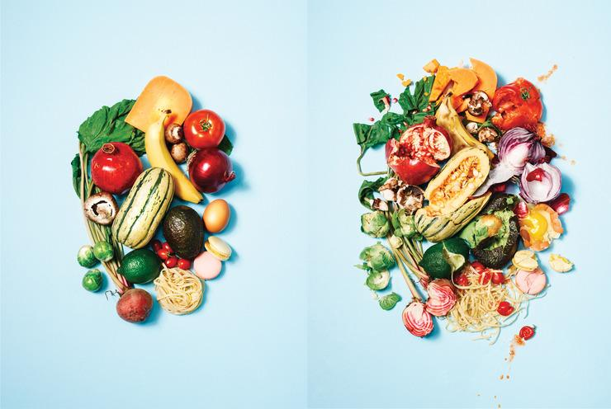


Slide 2
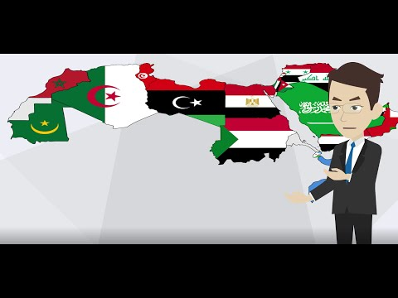
About Us
TAI will be the first Arabic food-sharing website. TAI connects people and allows them to share the food excess so the surplus food and other items won’t be a waste and thrown away. Our main goal is to reduce food waste.

Slide 3
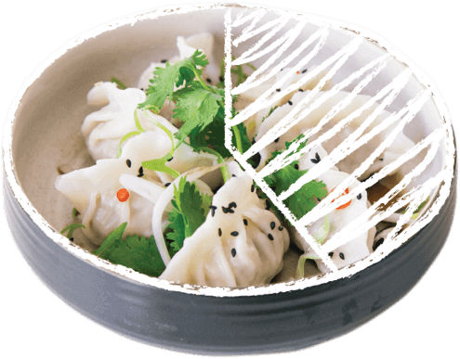
1/3 OF ALL FOOD IS WASTED
According to UN study

Slide 4
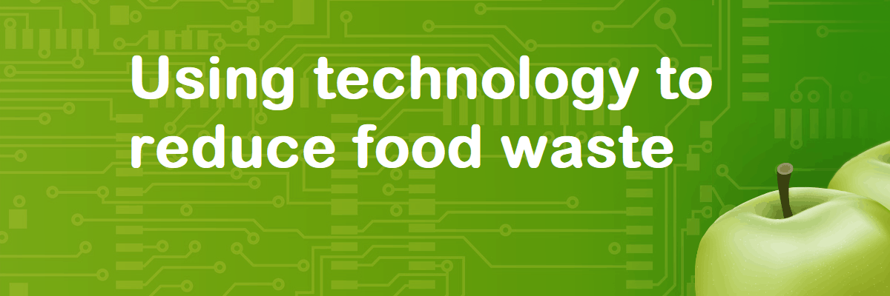
We will stop wasting food in just two small steps

Slide 5

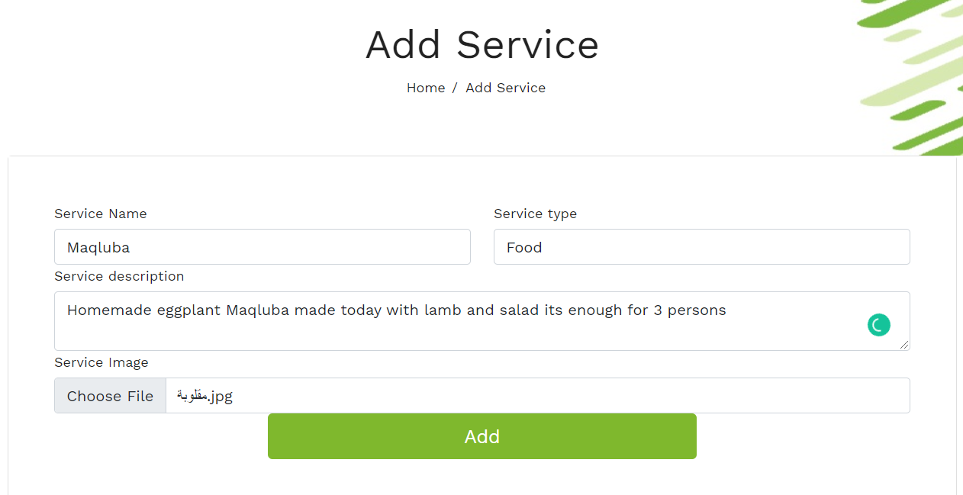
1- Add your service to our website

Slide 6
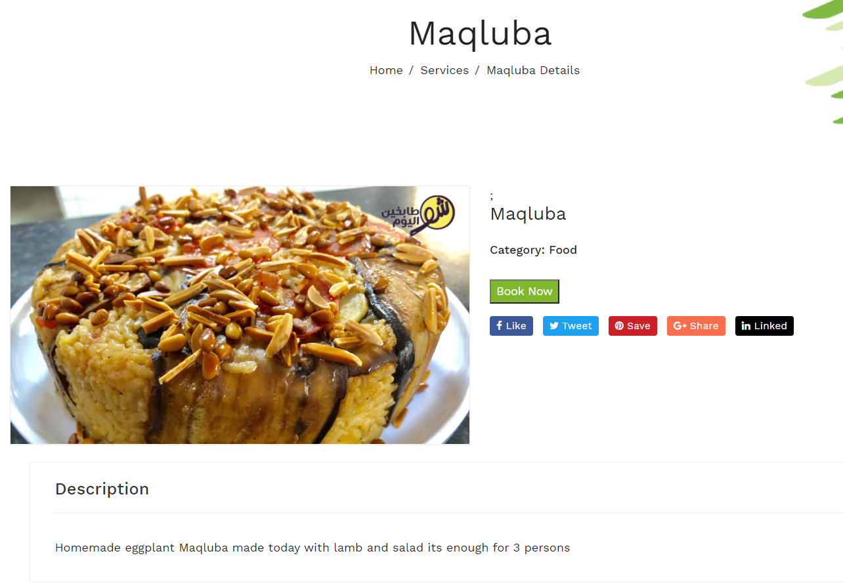

2- Your neighbors request the service

Slide 7
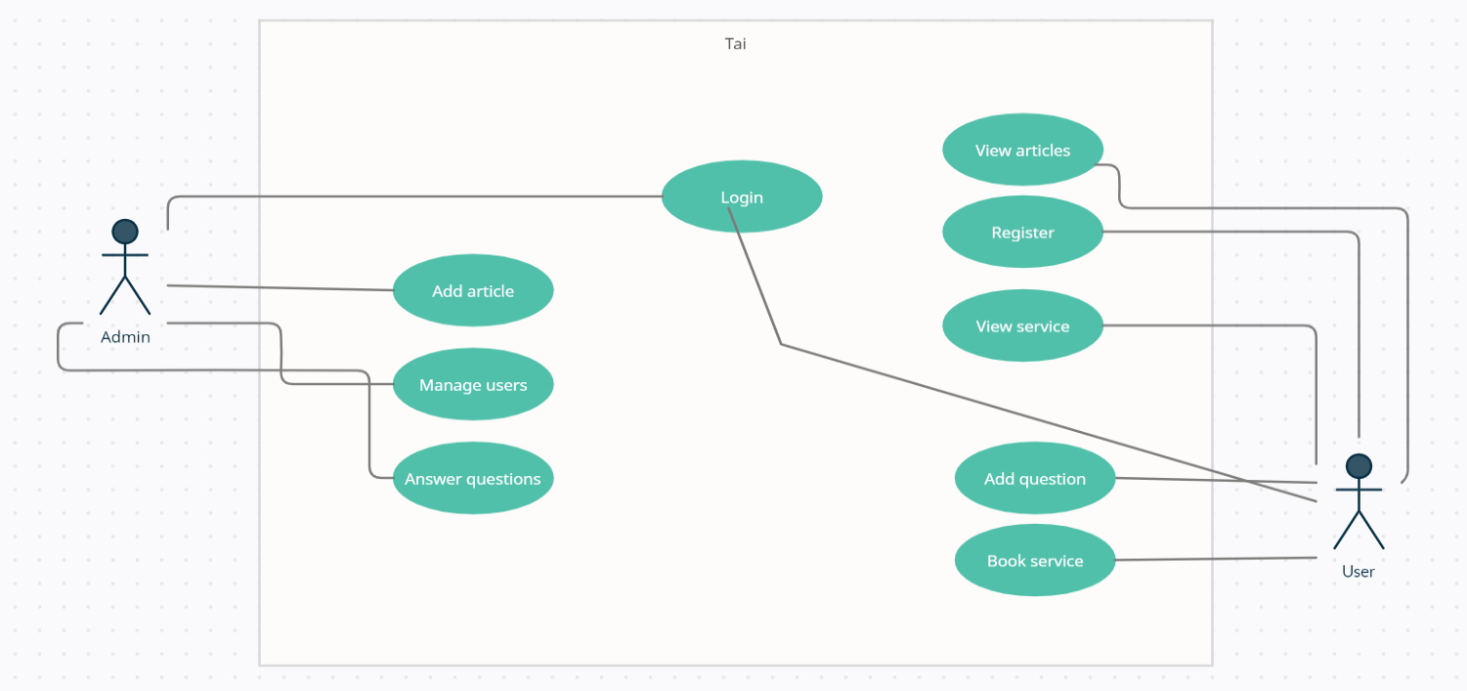
Use Case Diagram

Slide 8



Used technologies

Slide 9
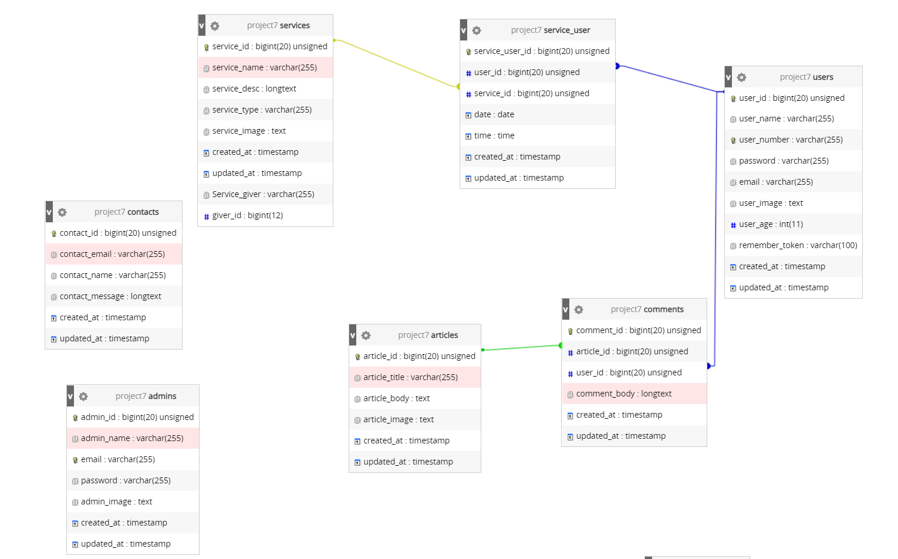
DATABASE
Notes:
relations

Slide 10
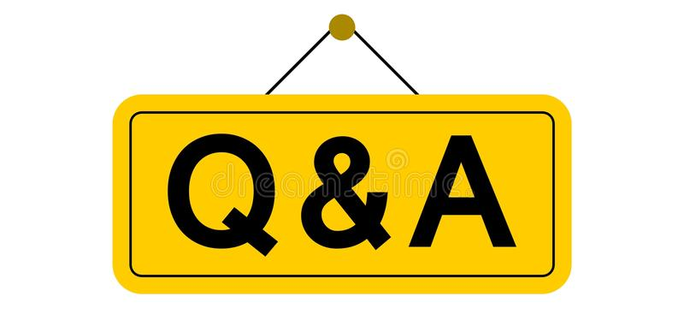

How we came up with the name ?
What type of items can I add to TAI
-You can add any edible food or any unwanted yet useful household items such as light bulbs, paint, chair, microwave, etc..
What does TAI do ?
-TAI is free website starting a Food sharing revolution to tackle food waste
How does TAI works?
What does make TAI safe for users?
-TAI is so simple, just add anything of value you have but don't want anymore, Your neighbours can see your service and request it from you, its a great way to meet new people too!
-When new user register he must ensure the correctness of their information when setting up their accounts(Of course, the information will be confidential and only used to verify the identity of the user).
-Only people who are over the age of 18 can register.

Slide 11


Slide 12


